Slide 1

Verbal Aggression Detection Data Mining and Artificial Intelligence Edward Hachem, Joyre Bohanon, Nick Fulton, Quinn Clark
CS 4850 – Senior Project
SPRING 2023
Professor Sharon Perry
Team: SP2-BLUE

Slide 2

Overview
Define Verbal Aggression and Parameters
Project Introduction and Goals
System Overview
To Be Implemented
Future Applications and Considerations

Slide 3
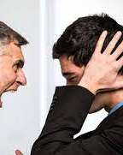
What is Verbal Aggression?
A verbal communication intended to cause psychological pain to another person, or perceived as having that intent
Examples: Name calling, insults, yelling, foul/profane language, etc.
Exists in professional and interpersonal relationships
Deteriorates communication and psychological safety

Slide 4
Project Introduction and Goals
Project Introduction
Goals
Raw data collection using web scraper YouTube API V-3 and Python
Spectrogram Storage: AWS S3 Bucket
Cloud Computing Facility: AWS EC2
Parameter Exploration and Data Analysis: Librosa 0.10.0 (Python Framework)
Output Visualization: PowerBI
Mine
Mine and mark training data videos as aggressive or non-aggressive
Convert
Convert aggressive and non-aggressive clips to Mel-Frequency Spectrograms
Train
Train Convolutional Neural Network (CNN) using K-Fold Cross Validation
Achieve
Achieve minimum 60% accuracy in verbal aggression detection
Implement
Implement detector in web application

Slide 5

System Overview

Slide 6
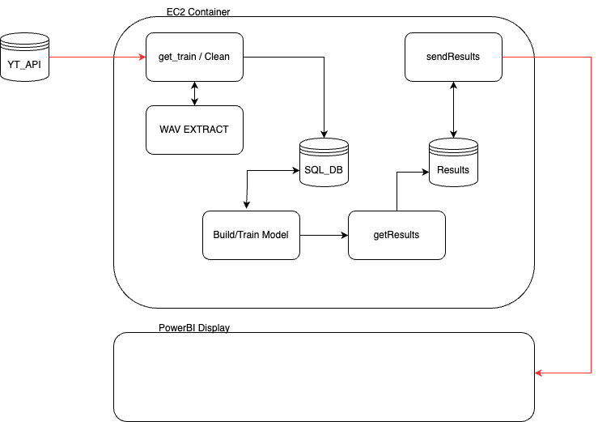

Slide 7
AWS EC2
Secure Cloud Compute Environment
GitHub connected to EC2 instance
Artifacts on EC2 instance:
Version control
Training and test data
Program execution
Notes:
EC2 or (Elastic Compute Cloud) is a web service that provides secure compute capacity in the cloud
Our GitHub is connected to an EC2 instance and version control is maintained on that instance
We are also storing our training and test data on the EC2 instance
Our program will be run from the EC2 instance

Slide 8

Web Scraping
Purpose: to ease automation of test data (video clip) collection
Python 3.2.1
Frameworks and Libraries
Pandas
GoogleApiClient.Discovery
Re
Os
Pickle
Outputs list of links by keyword search as Excel file

Slide 9

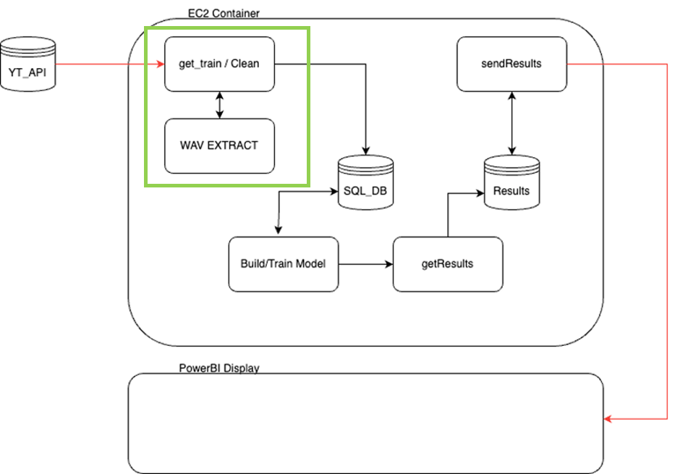



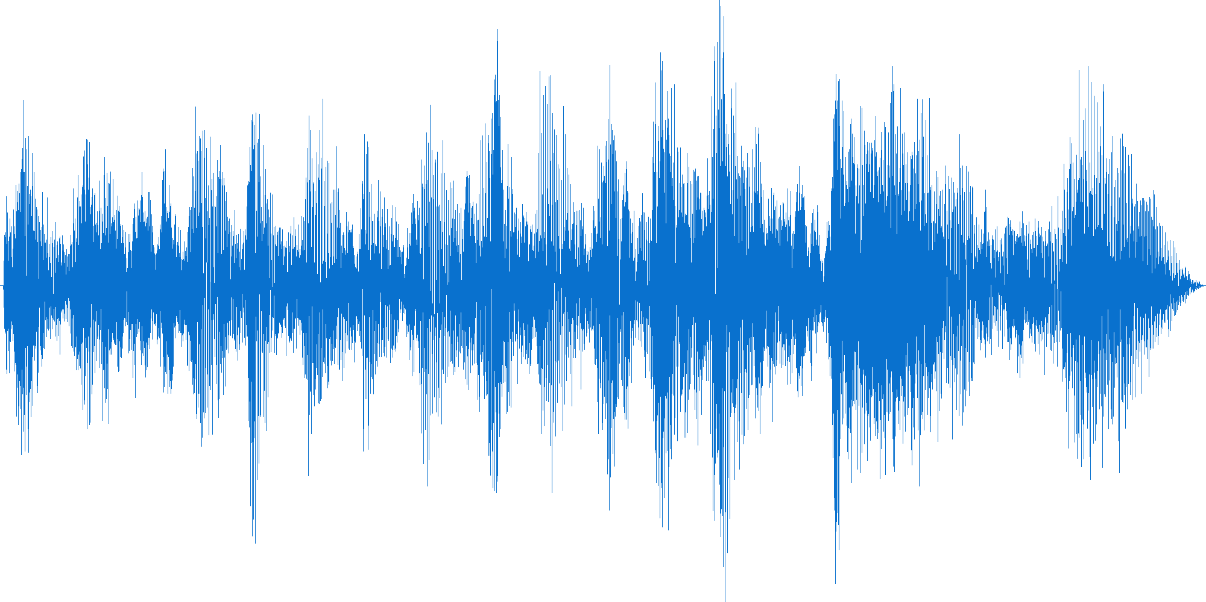
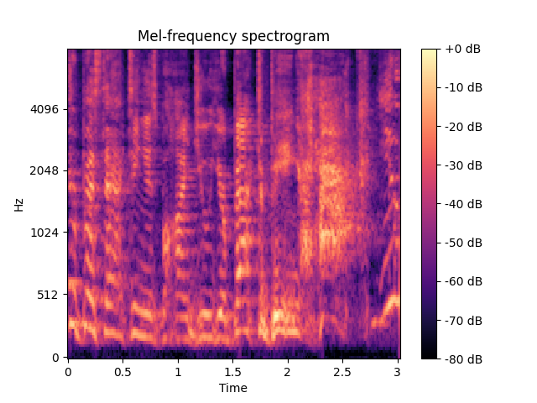
binary
Present Video Conversion
Video Conversion Process
Transform YouTube video to .m4a
Convert .m4a to .wav
Convert .wav to Mel Frequency Spectrogram
1. step 1
Step 2
Step 3

Slide 10
Future Video Conversion Process
Characterize YouTube Videos
Convert Binary Characterized Link to .m4a
Pre-process .m4a for noise reduction and volume normalization
Convert .m4a to .wav
Transfer .wav to database
Convert .wav Mel-Frequency Spectrogram
Notes:
Label YT video links as aggressive and nonaggressive
Convert yt link to .m4a format
Clean data
Convert m4a to .wav format
Transfer .wav to database connected to EC2 instance
Convert .wav to me-frequency spectrogram

Slide 11
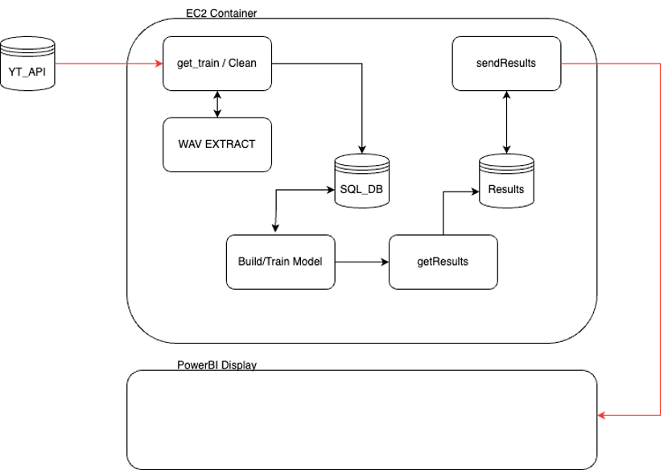
Model Training

Slide 12
Predictive CNN Model
Generated CSV file for file names in binary classification
Binary Classification Map: 0 -> aggression and 1 -> nonaggression
Predictive Model: Convolutional Neural Network (CNN)
Image Classification
Scalability
Robustness
Notes:
CHaving acquired the Mel Spectrogram images, a CSV file is created to hold the file names (x variable) and their corresponding labels (y variable)
We used a binary classification scheme for labeling: 0 -> aggression and 1 -> nonaggression
Our choice for the predictive model is a Convolutional Neural Network (CNN) and there are several reasons why:
Image Classification: CNNs are specifically designed for this task. They can highlight the presence of different features in the image, such as edges, corners, and textures.
Scalability: CNNs can be scaled up to handle large datasets and complex tasks, making them suitable for a wide range of applications.
Robustness: CNNs are robust to noise and distortions in images, making them effective in real-world applications.

Slide 13
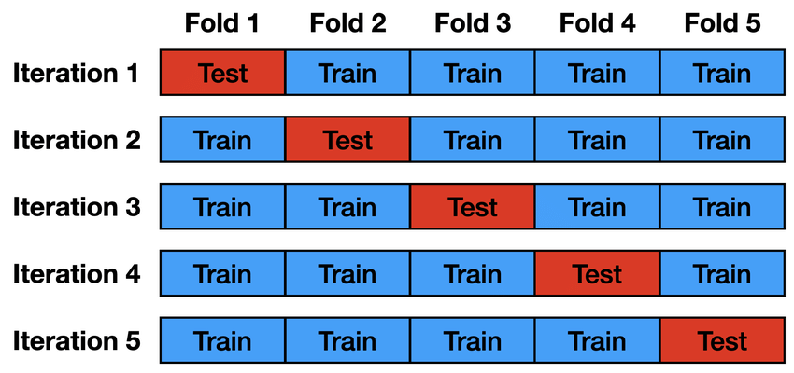
K-Fold Cross Validation and Model Training
K-Fold assists our limited dataset by granting more opportunities to train.
106 training examples
Training Method: K-Fold Cross Validation with k = 5.
divide the data into k equally sized folds, and then
train the model k times
Validation set = each iteration uses a different fold
training set = remaining folds
Notes:
Since we only possess 106 training examples at the time of this prototype, it is difficult to get a well performing model that can generalize.
Therefore, the model is trained using K-Fold Cross Validation with k = 5.
The idea is to divide the data into k equally sized folds, and then train the model k times, each time using a different fold as the validation set and the remaining folds as the training set.
K-Fold assists our limited dataset by granting more opportunities to train.

Slide 14
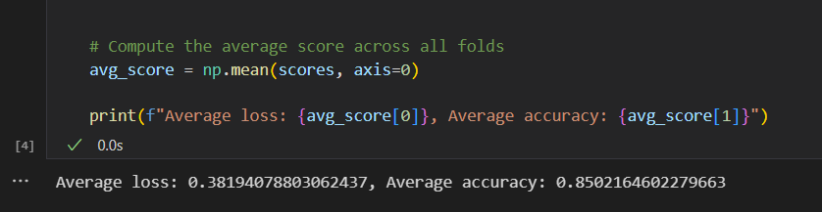
Model Training (cont.)
Training Method: K-Fold Cross Validation with k = 5 (cont.)
Test model on unseen Mel Spectrogram images
Record loss and accuracy for predictions
Average loss and accuracy across all folds
Current Output:
Notes:
At the end of training on each fold,
the model is tested on the unseen Mel Spectrogram images.
The loss and accuracy is recorded for the predictions.
Once training is complete, the loss and accuracy is averaged across all five folds and printed to the console.

Slide 15
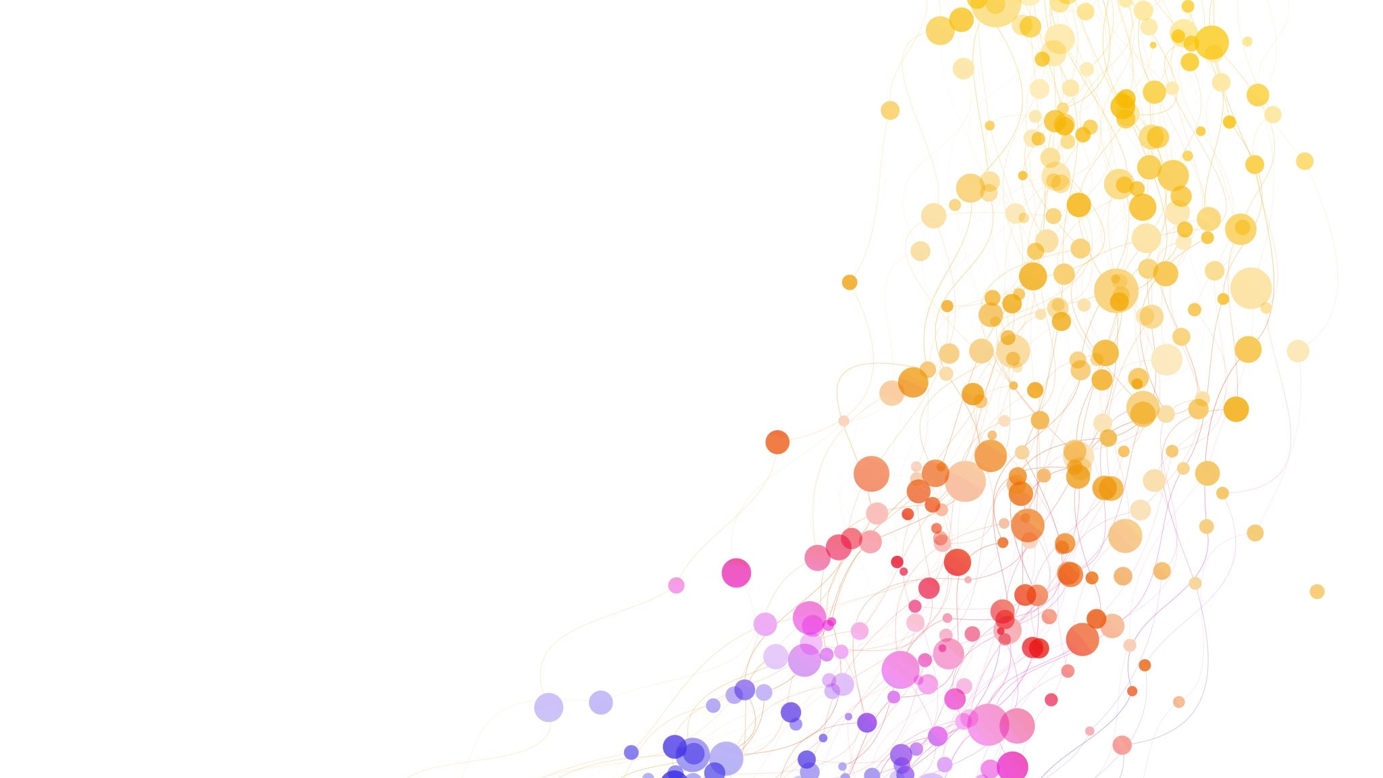
To Be Implemented…

Slide 16

Amazon Relational Database (RDS)
Power BI
EC2 instance can read and write to RDS databases
One table in RDS contains the YouTube links
Another table contains results/summary statistics from CNN output
Output Visualization
Success/failure rate graphics
Data models
Notes:
The EC2 instance our program is running on will be able to read and write to RDS databases.
One database will contain the YouTube links from web scraper along with their prioritization score, which is used for video selection.
Another database will contain summary statistics from the CNN output which will be read into Power BI.
Power BI will be used for output visualization of the summary statistics such as success and failure rates in the form of charts, graphs, and other data models.
This will need more research

Slide 17

Future Applications and Considerations
Collect more data and find a way to clean WAV files prior to Mel Spectrogram conversion.
Design and Implement web application that takes in live audio input via microphone.

